Slide 1

GEN_009/2026
Guidelines for requesting the floor and online participation IN the MEETING
25th Special Meeting of the Commission
Hybrid format, 16-23 November 2026

Slide 2
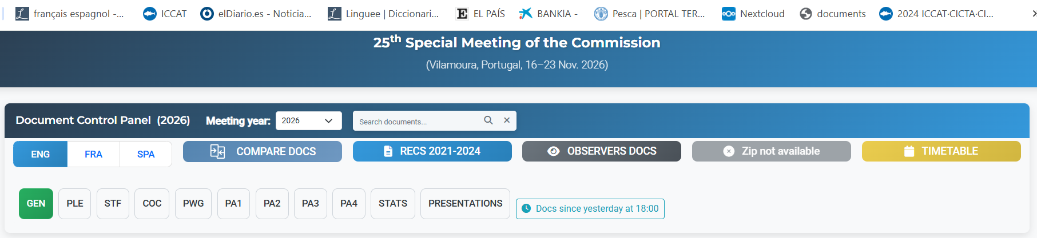
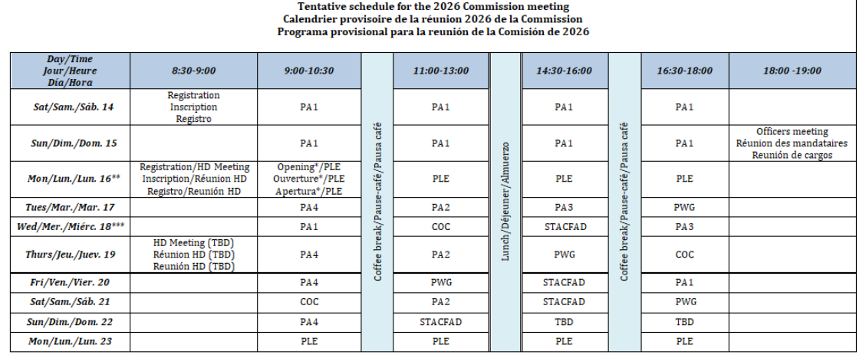
1. Meeting logistics
Meeting documents available here
Observers’ documents available here
Timetable (UTC/GMT +1, Spain time):
Check document GEN_002

Slide 3
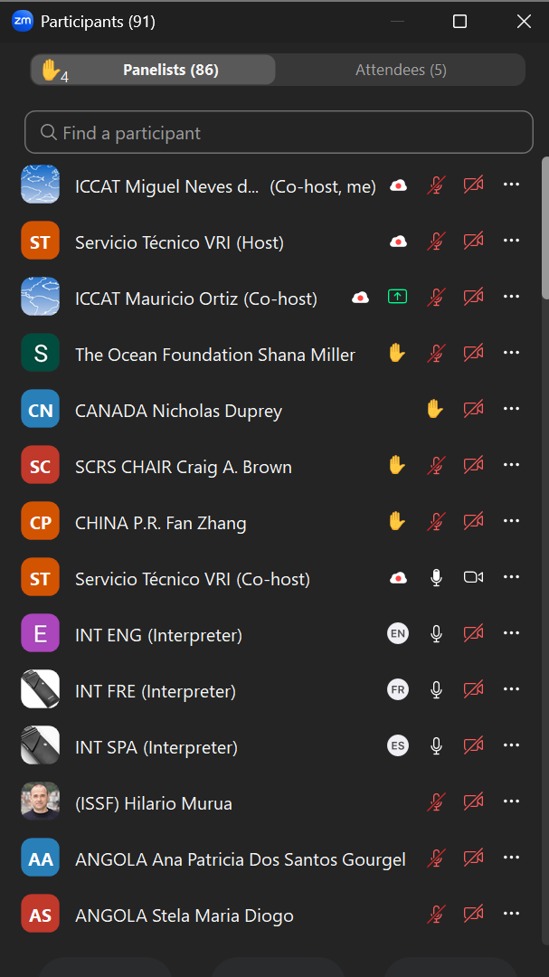

2. General guidelines for panelists (1/2)
ZOOM invitation are personal and shall not be shared with anyone
Ensure that the name of your Delegation followed by your name and surname appear in the name box (e.g. ICCAT Camille Manel)
Order of requests for access to the floor will be shown on the Zoom participants list
If you are attending the meeting in-person and as a panelist:
All in-person participants who are allowed to speak on behalf of their delegation should connect to ZOOM, using the ZOOM personal invitation received by e-mail
Raise your hand to request the floor by clicking the button in the Toolbar and lower your hand when you finished
Make sure your computer microphone is muted at all times

Slide 4
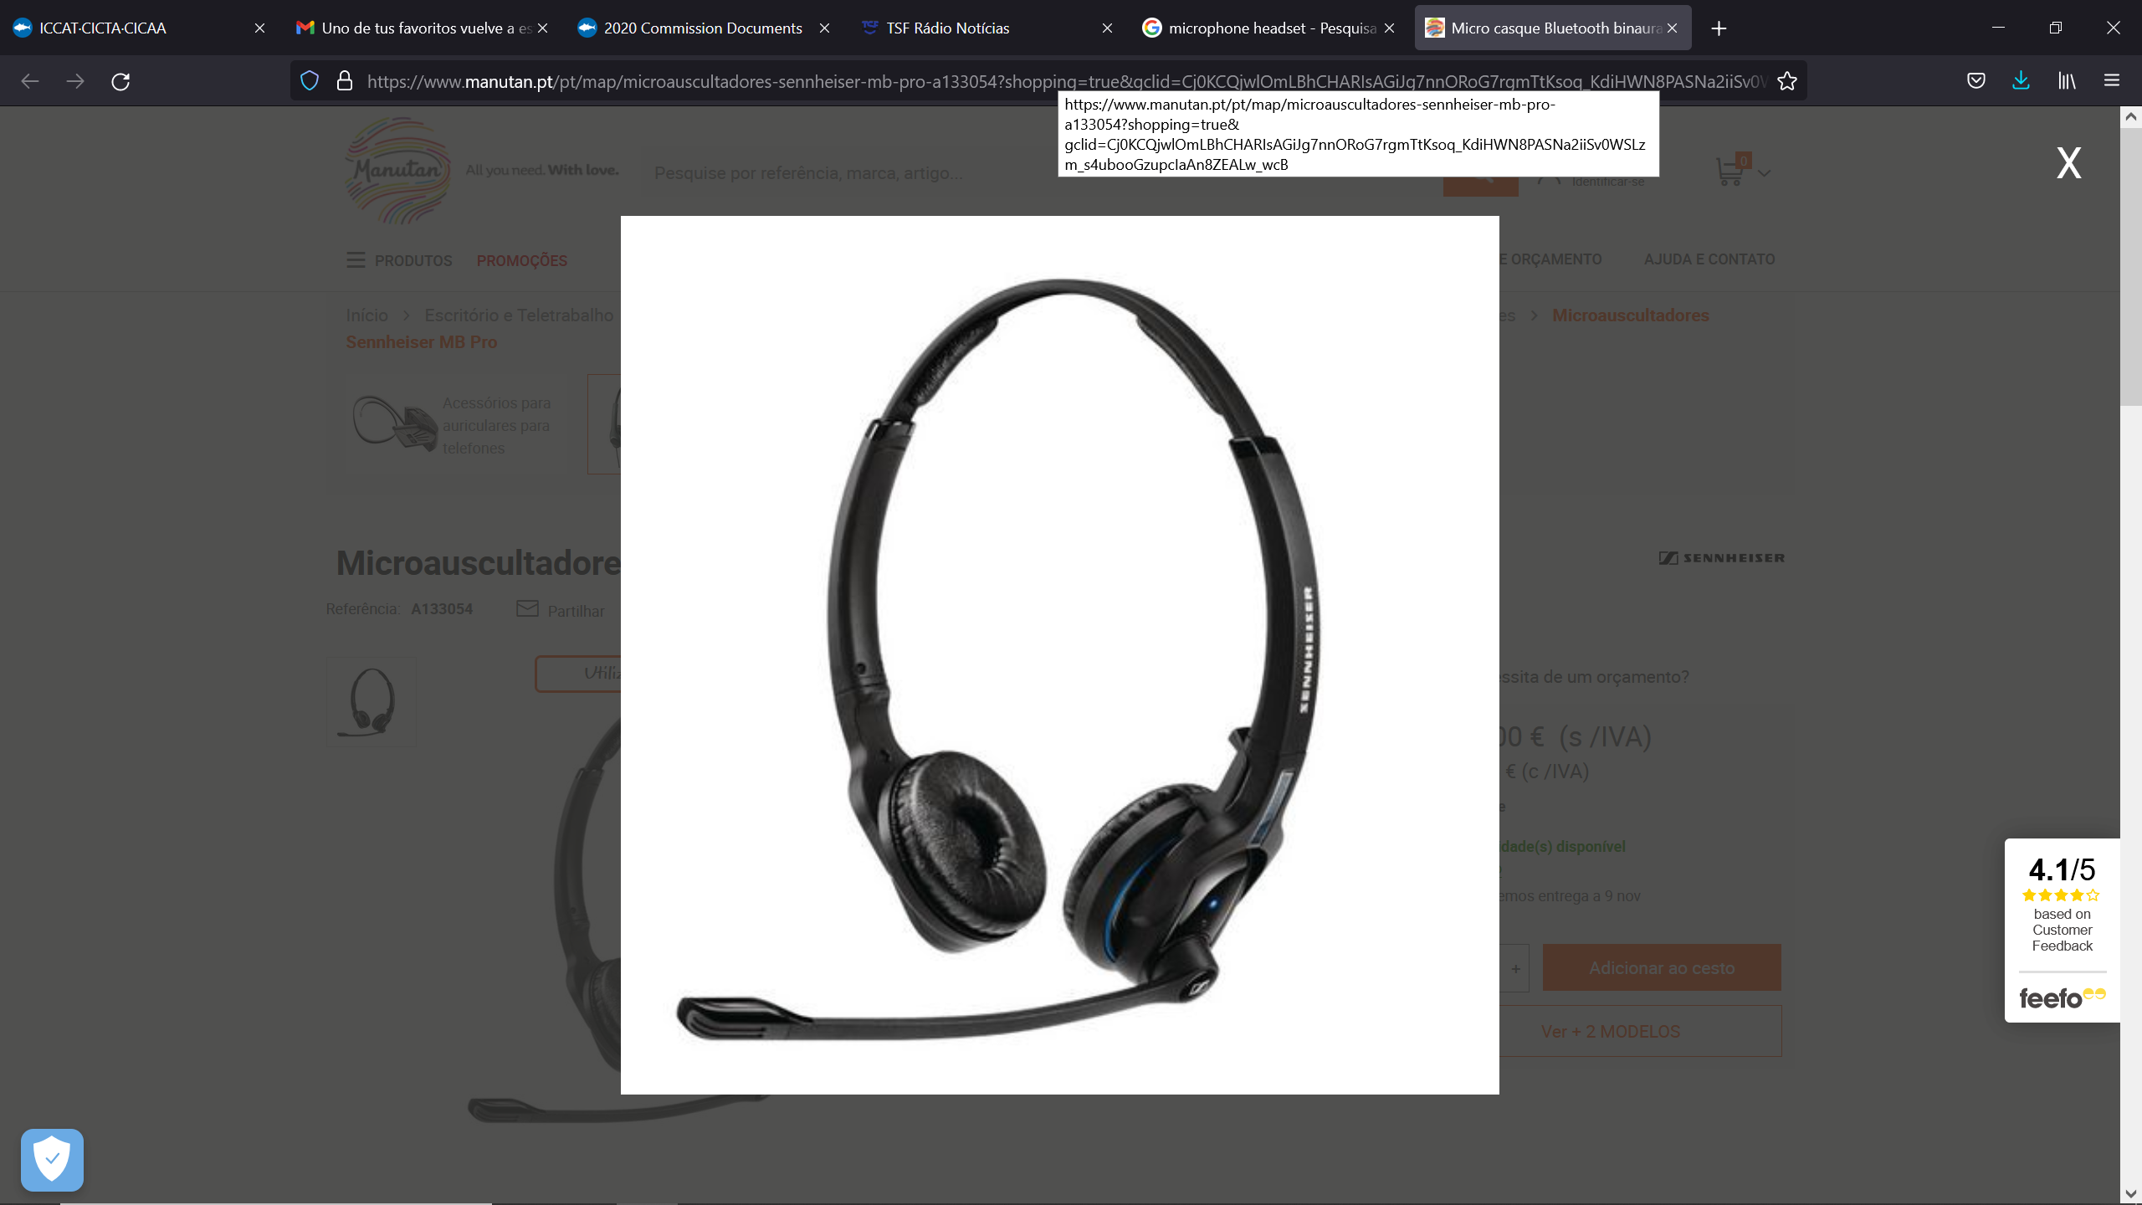


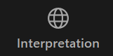
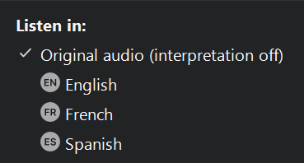
2. General guidelines for panelists (2/2)
If you are attending the meeting online as a panellist :
Using a microphone headset is recommended
Make sure that the microphone is turned on only once the Chair has given you the floor
Turn off all sound notifications (Skype, WhatsApp, emails, etc.) while attending the meeting and ensure that you are in a place with no background noise or echo
Maintain your microphone muted and video camera inactive unless speaking
Once the Chair gives you the floor, unmute your microphone, turn on your camera (helps interpreters) and speak slowly
Lower your hand by clicking the button in the Toolbar when you finished
Under in the interpretation feature choose your language of preference from English, French, Spanish and Arabic
You may mute the original audio (optional)

Slide 5
3. General guidelines other online participants
Access the meeting preferably with the official Zoom client (the web client has some limitations)
Ensure that the name of your Delegation followed by your name and surname appears in the name box (e.g. ICCAT Camille Manel).
Please note that you will not have access to the floor (to speak) but will have access to other ZOOM features
Under in the interpretation feature choose your language of preference from English, French, Spanish and Arabic
You may mute the original audio (optional)

Slide 6
4. Chat
  Chats may be sent to everyone or to specific delegates
  Chats may not get an answer and may not be formally incorporated into the report
  Often good to type a comment that has been made verbally
  Very good for offering text suggestions - but please follow with a verbal comment
  Useful for agreement or disagreement (yes/no) parallel discussions
  Be aware that all chats will be recorded

Slide 7
5. Rapporteuring / Report requests
Take notes during the session
Once the meeting is closed, the draft report must be provided to the Chair and Secretariat, as soon as possible

Slide 8
6. Guidelines for Observers
Any eligible Observers admitted to the meeting may:
attend meeting sessions, but cannot vote;
make oral statements during the meeting upon invitation from the Chair;
distribute documents at the meeting through the Secretariat, to be posted on the meeting documents webpage;
engage in other activities, as appropriate and as approved by the Chair.

