Slide 1

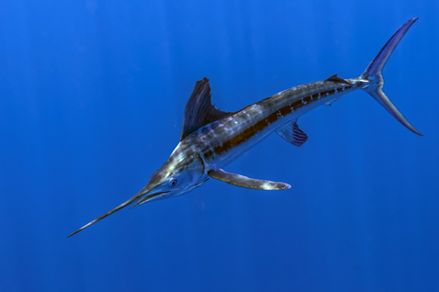
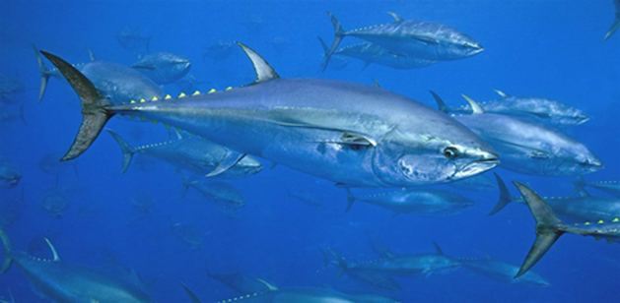
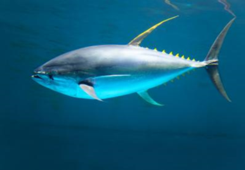

Report of the 2022 Standing Committee of Research and Statistics (SCRS) to the ICCAT Plenary
ICCAT Plenary 2022
Vale do Lobo, Portugal
November 14, 2022
Dr. Gary D. Melvin
SCRS Chair
Complete SCRS Report available online

Slide 2
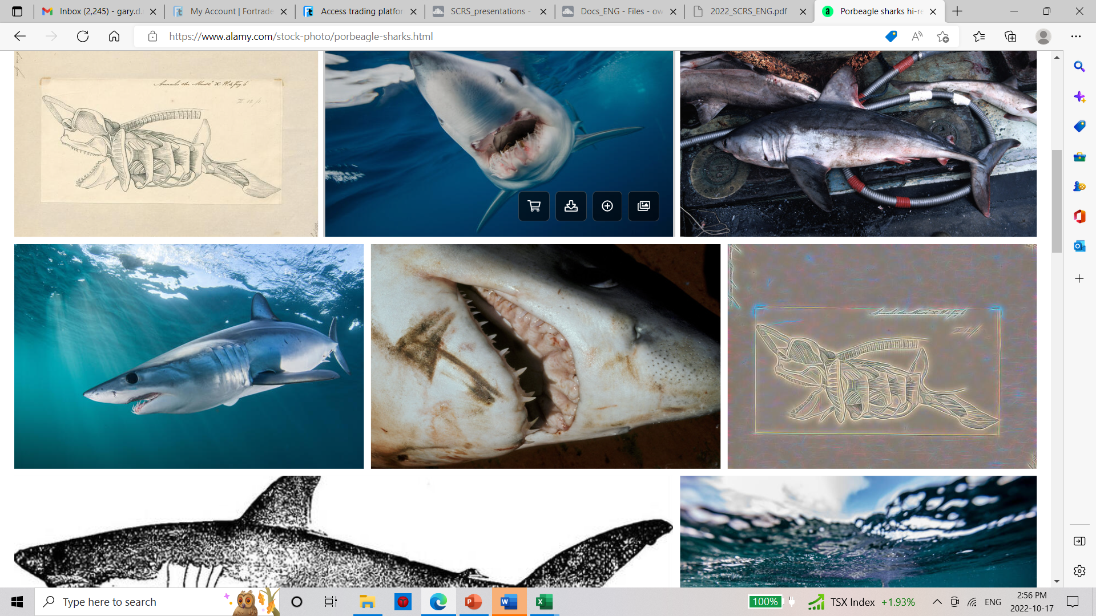
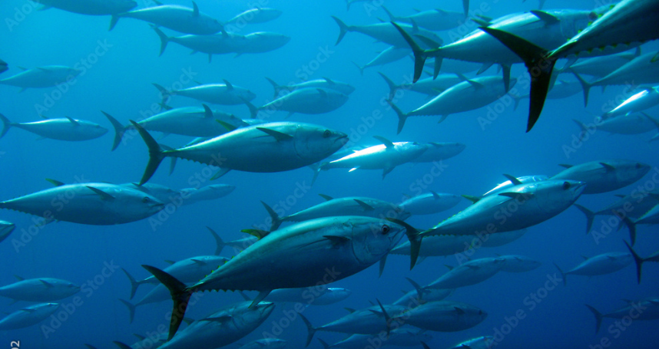
2022 Presentation Overview
General Activities:
- SCRS Accomplishments and Challenges
- Secretariat activities in research and statistics
- Summary of Intersessional SCRS meetings
-. Overview Research Programs.
- Estimated SCRS Interpretation Costs
Specific Activities:
- Executive Summaries (Details provided in Panel)
- Management Strategy Evaluation (MSE)
- Recommendations to Commission

Slide 3
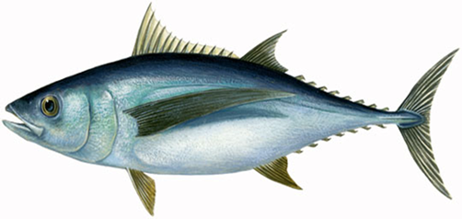
SCRS Challenges for 2022:
The non-traditional Operations due to Covid 19 imposed restrictions.
Transition from in-person to virtual meetings and now hybrid meetings.
Reduced time for virtual meetings (4.5 hour vs 8), and now back for Hybrid
Continuously increasing workloads for SCRS members and the Secretariat
Postponement of several important meetings and workshops. (Catchup)
Reduction in the time allocation for scientific/research paper presentation/review,
Expansion of MSE for BFT, SWO, ALB, and tropical tunas

Slide 4
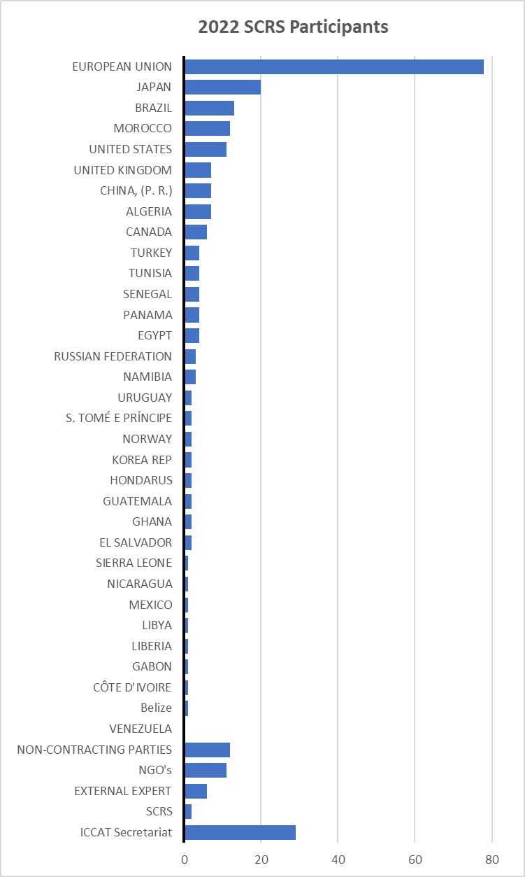
2022 SCRS Accomplishments
Extremely Demanding workload for all involved with the SCRS.
Six Stock Assessments: eBFT, East and West Skipjack, North and South SWO, and Porbeagle
Sixteen Intersessional Meetings: BFT, BET, SWO, ECO, WGSAM, Billfish, Panel 1, Panel 2, SMT, ALB
Numerous ad hoc virtual meetings to deal with WG specific issues
Multiple MSE meetings associated with; BFT, ALB, TT and SWO.
2019 2021 2022
Participants: 207 258 281
CPC: 160 199 211
Non CP 1 1 12
NGO’s: 4 20 11
Secretariat: 27 24 29
Reports of 2022 SCRS Species working groups/Plenary Meetings
- 281 participants from 33CPC’s
- 189 SRCS Papers submitted up to Sept 2022
- 67 Presentations
- 6 Ambassador MSE meetings, and
- 39 responses to the Commission

Slide 5
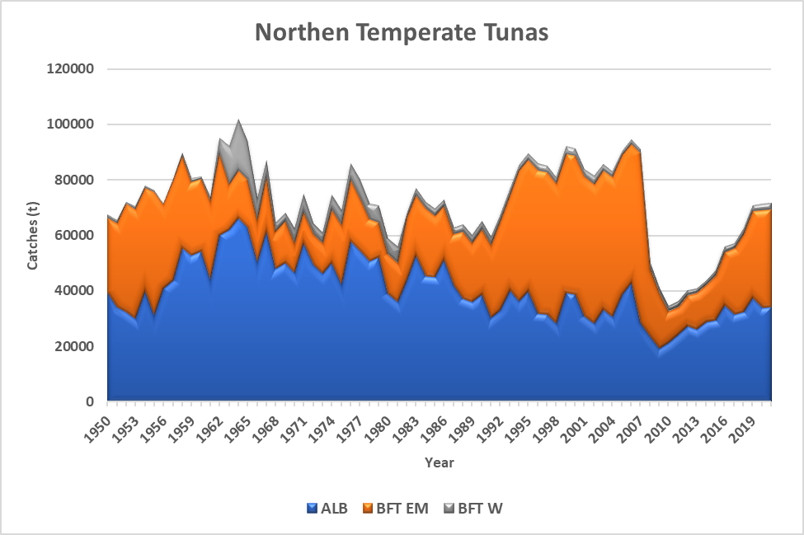
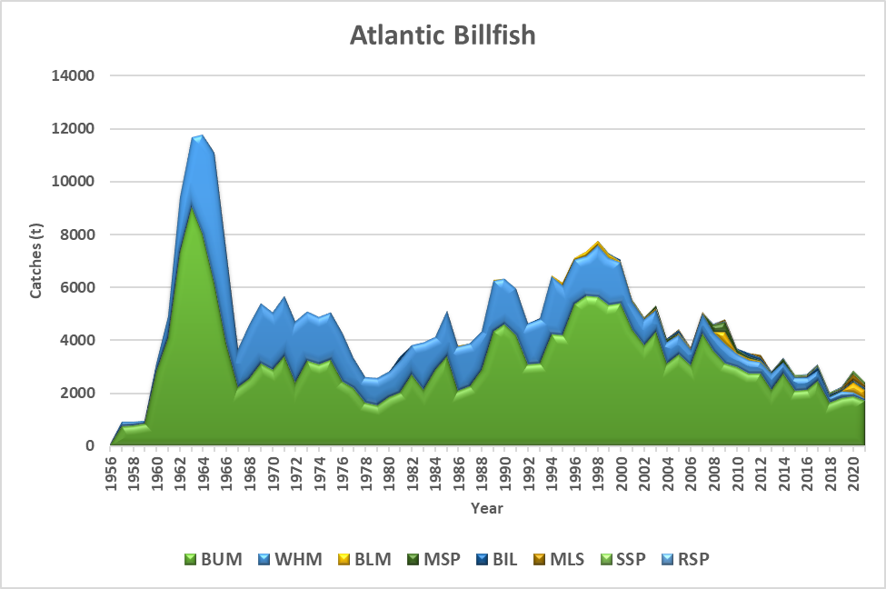
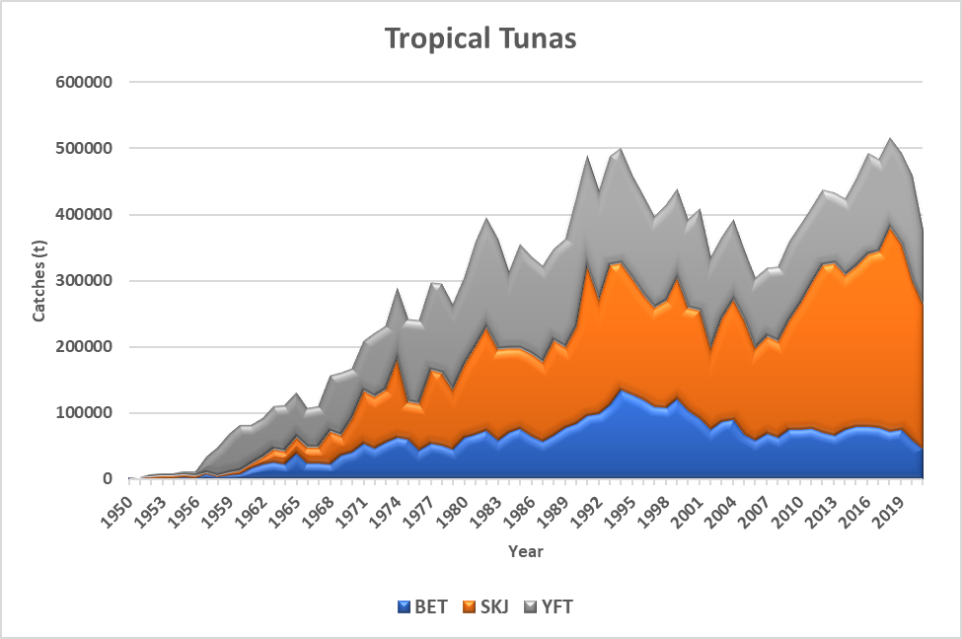
Secretariat Activities in Research and Statistics
The ICCAT Secretariat provides critical technical and logistical support to the SCRS in all the aspects of the Standing Committee’s work. This includes support for coordination of meetings, multiple research programs, database management of fishery data reported to ICCAT, coordination of SCRS report and document publication, contracting, meeting coordination, capacity building initiatives, and training. Without this support much of the work accomplished by the SCRS would be impossible.
BillFishes

Slide 6
Secretariat contribution
In addition to the normal activities on statistics, publications, data, funds management and other duties, the Secretariat has
Dedicated a lot of additional work to the preparation of and attendance to SCRS meetings (virtual and Hybrid - 38 SCRS and COM/SCRS official online and 11 workshops and SCRS Technical subgroups Mtg.
Participation in an excessive number (6) stock assessments and associated data prep meetings.
Highlighted the effort being made on the development of the ICCAT Integrated Online Management System (IOMS)
Updated and expansion of Chapter 2 of the ICCAT Manual, including translation.
International cooperation. : UN Marine Biodiversity of Areas Beyond National Jurisdiction (BBNJ) process, FAO Committee of Fisheries (COFI), FAO Coordinating Working Group on Fishery Statistics (CWP), General Fisheries Commission for the Mediterranean (GFCM), International Council for the Exploration of the Sea (ICES), Western Central Atlantic Fishery Commission (WECAFC), Mediterranean Advisory Council (MEDAC), Convention on International Trade in Endangered Species of Wild Fauna and Flora (CITES), EU Regional Coordination Group Large Pelagics (RCG LP) and Regional Fishery Body Secretariats’ Network (RSN)
And much more!!!

Slide 7
Report of intersessional SCRS meetings
Brief summary of Intersessional meetings held between late 2021 and 2022. Details of each meeting are available in the meeting reports.
Northeastern Atlantic Porbeagle (Exec Summary –Section 9.4)
  ICCAT-ICES Northeastern Atlantic Porbeagle Data Compilation Workshops, Dec through Feb to define stock structure and data series in preparation for 2022 benchmark assessment. No evidence to sub-divide the current stock into smaller units, however the southern boundary was expanded from 36⁰ N to 5⁰ N to align with ICCAT. Indices of abundance for the assessment were also decided.
  ICCAT-ICES Northeastern Atlantic Porbeagle Benchmark Meeting (April 29th). The Working Group decided on input data (catch, CPUE) for stock assessment, defined the priors for SPiCT/JABBA models, and undertook exploratory assessments with both models.

Slide 8
Report of intersessional SCRS meetings
Northeastern Atlantic Porbeagle (Continued)
  ICCAT-ICES Northeastern Atlantic Porbeagle Stock Assessment Meeting. June 15-17 in Lisbon, Portugal. SPiCT assessment model was re-run with updated data and presented. ICES notified ICCAT of a generic harvest control rule (HCR) that it intended to apply.
  Based on this the TAC for the NE Porbeagle would be of 432t for 2023 and 599t for 2024 compared to the reported ICCAT catches for NE Porbeagle of approximately 8 t.
  ICCAT concerned about a generic HCR and tested to achieve objectives unknown to ICCAT. As well, the future availability of a required index of abundance to apply this HCR was in doubt. Regardless, the WGEF chair decided to proceed with constant catch projections (July13th).
  During the review, problems were discovered that could not be resolved during the meeting. The ICES sub-group agreed to wait until November to have an “inter-benchmark” to address the issues.

Slide 9
Report of intersessional SCRS meetings
Intersessional Meeting of the Sharks Species Group (16 to 18 May)
Committee revised the information available on fishery statistics and convectional tagging for BSH, SMA, and POR, and a Group of other bycatch shark species. The Committee reiterated CPCs requirement to report discards (both dead and alive) of the three species and expressed concerns about species identification.
Group reviewed the Shark Research and Data Collection Programme (SRDCP) activities and its progress. Began preparation for the 2023 Blue Shark stock assessment and reviewed of the results from the 2015 BSH Stock Assessment Meeting.

Slide 10
Report of intersessional SCRS meetings
Skipjack Tuna:
Skipjack Data Preparatory Meeting(Feb 21 to 25)
Reviewed the new data on fisheries, biology and tagging, updated catch data, agreed the last year for the assessment models would be 2020. Estimated“Faux poisson” catches from the purse-seine FAD fishing operations between 2015 and 2020. Agreed the assessment to be based on a surplus production model (JABBA) and a statistical catch model (Stock Synthesis 3) for the east and west stocks.
Skipjack Stock Assessment Meeting (May 23 to 27).
Assessments undertaken for this meeting. For the west stable model fits could be used to provide management advice, however for the east additional intersessional work was required. The final assessment to be adopted at the Sept TT species group meeting.

Slide 11
Report of intersessional SCRS meetings
East Atlantic and Mediterranean Bluefin Tuna :
eBFT Data Preparatory Meeting(Apr 18-26) – Section 8.4
Harmonization of input data for the stock assessment and the MSE OM’s. Catch statistics and indices were updated. Three assessments models identified for bluefin tuna - Virtual Population Analysis (VPA), the Stock Synthesis model, and the Age-Structured Assessment Program (ASAP).
eBluefin Tuna Stock Assessment Meeting (July 4-9). - Section 8.13
The three models showed similar trends in SSB, but with a wide range of stock status relative to the F0.1 reference level. Advice deferred until Sept. (details in Exec Sum)
BFT MSE
Additional work reviewed on MSE performance indicators, management cycle and stability provisions were discussed.

Slide 12
Report of intersessional SCRS meetings
Atlantic Swordfish:
Atlantic Swordfish Data Preparatory Meeting (including N-SWO MSE) – Section 8.3
Review data inputs for the 2022 North and South Atlantic stock assessments and a review of progress on North Atlantic swordfish management strategy evaluation (N-SWO MSE). Also reviewed new biological information associated with the ICCAT swordfish biological research programme (SWOYP). 8 indices were recommended for use in the North and 6 in the South. Core teams were formed to develop Stock Synthesis, JABBA, and ASPIC models.
Atlantic Swordfish Stock Assessment Meeting (June 20-28). - Section 8.12
For the northern and southern stocks the Group reviewed Stock Synthesis and JABBA models for stock assessments. Final projections for Stock Synthesis could not be finished during the meeting so were deferred to the September. Details to be provided in appropriate Panel Presentations

Slide 13
2022 intersessional SCRS meetings
Bluefin Tuna Technical Sub-group on MSE: Main focus was on communication, understanding the MSE approach and coordination of MSE inputs and process with Panel 2.
First Intersessional Meeting (May 3-6) – Section 8.6
Continuation of MSE process with an CMP update, review of performance indicators, tuning levels and TAC change. Also discussed the contents of documents and presentations for the Second 2022 Ambassadors Webinar on Bluefin Tuna MSE (October 2022) and the Second Intersessional Meeting of Panel 2.
Second Intersessional Meeting (Sept 5 to 9th) - Section 8.14
The Group reviewed updates to indices of abundance, changes to CMPs based on the input of the Third Intersessional Meeting of Panel 2, and the updated CMP results. Based on the Panel 2 input, tuning targets were developed for the developers for PKG, management cycle and TAC adjustments. Results were presented to Panel 2 in October.

Slide 14
2022 intersessional SCRS meetings
Intersessional Meeting of the Working Group on Stock Assessment Methods (May 31 – 3): Section 8.10
The meeting focused on management strategy evaluations (MSE), stock assessment, bycatch estimation and CPUE standardization and diagnostics.
The group identified communication with consistent messaging as as a key feature common to all MSE’s. They also noted Exceptional Circumstances should identify values not observed within the MSE projections.
The group concluded that the bycatch estimation tool (under development) performed well and produced reasonably unbiased estimates of total blue marlin bycatch and needs to be expanded beyond billfish and sharks.
It was noted that WGSAM provides tools for scientists to address their statistical and modelling problems.

Slide 15
2022 intersessional SCRS meetings
Tropical Tunas MSE Technical Sub-group Meeting (May 19 – 20): Section 8.8
The Sub-group addressed the state of development of the MSEs for tropical tunas, reviewed an update in the initial operating models for the WSKJ MSE, conditioning, and preliminary outcomes for 11 OMs under 12 MPs using 4 PMs including Constant Catch (CC) and index-slope Harvest Control Rules (HCRs).
The multi-species MSE is not as advance as the wSKJ with much work to be completed. The Sub-group identified the key tasks needed to complete a multi-species MSE.
The Sub-group recommended the formation of a team of ambassadors, with native speakers of each of the three official ICCAT languages, for the purpose of developing communication materials, organizing, and engaging in stakeholder outreach efforts related to MSE.

Slide 16

Report of the Subcommittee on Statistics
The Subcommittee updated current CPCs reporting status (SCRS Report Cards), improvements made in statistics (historical revisions and recoveries), associated data management tools (databases, infrastructure, applications), and progress made on current projects (historical data recoveries, IOMS).
The Sub-committee emphasized the failure of most CPCs to comply with the mandatory reporting of both dead and live discards in Task 1.
The Sub-committee acknowledged the usefulness of the inhouse developed Dashboard for catch data.
Highlighted the need for active participation of Species Group rapporteurs and CPC statistical correspondents in the Sub-Committee.
The Subcommittee acknowledged the importance of the IOMS project and reiterates its full support for the IOMS project, and its development.
Two Recommendations:
  SC-STAT meeting report be posted on Owncloud prior to being send for translation, and
  that the Task 1 summary table formats be examined and revised intersessionally and a proposal be presented at 2023 meeting of the Subcommittee of Statistics.
Details of the Secretariat activities are contained in Appendix 11 of the SCRS report
Notes:
Ongoing tasks in addition regular activities include:
Continue the development of EFFDIS
Prepare a draft proposal for a workplan to guide the development of the Task 3 Biological database
Prepare and make readily available the list of head of scientific delegations
CPCs recover historical catch and effort data and apply the proper units of effort
Species Groups provide the Secretariat with the range of lengths and weights that are considered biologically acceptable for each species.

Slide 17
Statistical and biological reporting status - 2021
  SCRS scorecard (1992-21) on Task 1/2 data availability (right)
    Unique table with scores (0-10) for all major species (including SMT species)
    Each value scores 1 SCRS catalogue
    Right column: % comparison with previous 30 years series (1992-2021)
    Observed - general increase in scores (last 5 years)
    Retrospective “scores”: SMA-S (below)
ICCAT Secretariat

Slide 18
Report of the Subcommittee on Statistics
Subcommittee on Statistics Workplan for 2023:
Upgrade all the ICCAT-DB system from MS-SQL server 2016 to MS-SQL server 2019
Replace the stand-alone MS-ACCESS Task 2 databases on the web by SQLite equivalent ones
Improve the “client applications” that manage the databases of the ICCAT-DB system
Continue the development of the statistical/tagging dashboards (dynamic querying)
Continue the tagging database development for both conventional and electronic tagging
Continue the Biological Sampling database development (includes data recovery/integration)
Continue the standardization of the electronic forms (TG: tagging forms, CP: compliance forms)
Extend the automatic data integration tools for the standardized electronic forms
Continue the development of the GIS project (create a PostGIS server and geo-reference all the ICCAT data available in ICCAT-DB)
The adaptation/migration of all the databases of the ICCAT-DB system to the new ICCAT IOMS system
Recommendations with Financial implications:
The Subcommittee recommended continued development of front-end applications for making and publishing graphically dashboards of ICCAT statistical datasets and provide the necessary financial resources for its continued development (€6,000). The full development of these important tools will require additional funding.

Slide 19
Ecosystems and By Catch

Slide 20
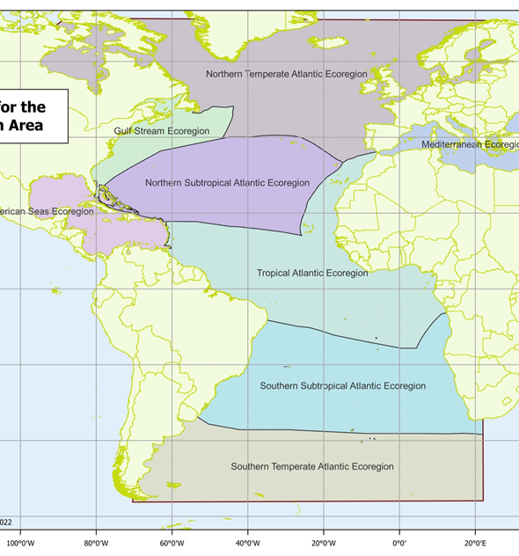
SC-ECO Highlights
Comprehensive risk assessment tool is being developed to identify priority ICCAT species for management action
Assessment framework proposed that will provide stock status for all data poor and data rich species
Preliminary ecoregions defined for reporting fishery impacts on the ecosystem (see inset)
Mechanisms identified to frame single species status within an ecosystem context (e.g., Res 11-14, para 9, Res 13-15, para1 on relevant Executive Summary content; Responses to Commission)

Slide 21
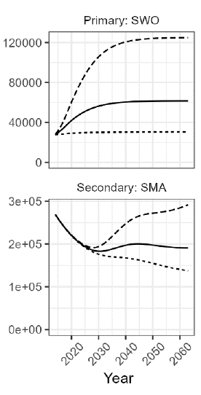
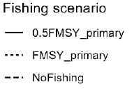
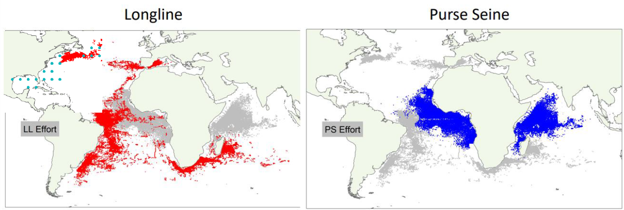
SC-ECO Highlights
Updated meta-analysis identifies multi species trade-offs of using Circle vs J hooks
MSE tool (Ecotest) developed that can show impact on bycatch species caused by management of target species (left)
Collaborative process shows spatio-temporal trends in sea turtle bycatch in the Atlantic and Indian Oceans (below)

Slide 22
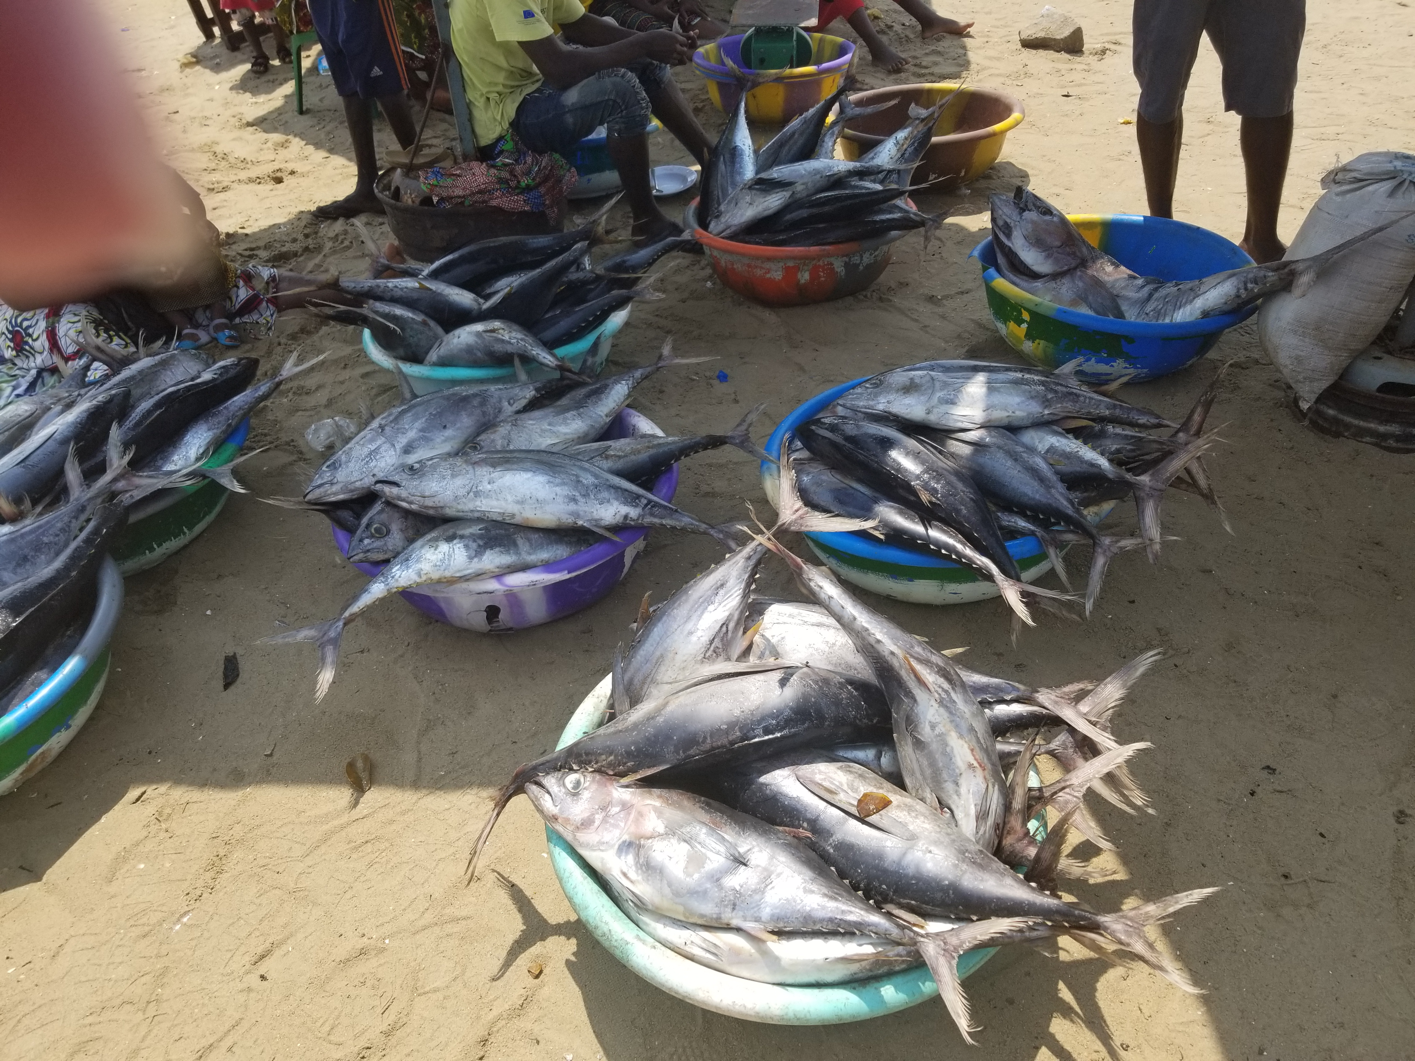
2022 Overview of ICCAT Stock Status
Details of assessed stocks to be presented during the Panel meetings.
Summary 2022 ICCAT Stock Status – 25
Overfishing (F>Fmsy) |  |  | Overfished (B<Bmsy)
Yes | No | Unknown | Yes | No | Unknown
6 | 16 | 3 | 11 | 8 | 6

Slide 23
Overview Stock Status
Details for 2022 assessed stock to be presented during the Panel meetings.
Stock | Overfishing | Overfished | Data year | Assessment Year | Projections | TAC
SKJ_E | No | No | 2020 | 2022 | Yes | Yes
SKJ_W | No | No | 2020 | 2022 | Yes | Yes
YFT | No | No | 2018 | 2019 | Yes | Yes
ALB_N | No | No | 2018 | 2020 | Yes | Yes
ALB_S | No | No | 2018 | 2020 | Yes | Yes
SAI_W | Not Likely | Not Likely | 2014 | 2016 | No | No
SWO_N | No | No | 2020 | 2022 | Yes | Yes
BSH_N | Not Likely | Not Likely | 2013 | 2015 | No | Yes
BFT_E | No |  | 2020 | 2022 | No | No
BFT_W | No | Unknown | 2020 | 2021 | Short Term | Yes
No Overfishing and not Overfished
2022 Assessed Stocks

Slide 24
Overview Stock Status
Details for 2022 assessed stock to be presented during the panel meetings.
Stock | Overfishing | Overfished | Data Year | Assessment Year | Projections | TAC
BET | No | Yes | 2019 | 2021 | Yes | Yes
ALB Med | Yes | Yes | 2018 | 2020 | Yes | Yes
BUM | Yes | Yes | 2016 | 2018 | Yes | Yes
WHM | No | Yes | 2017 | 2019 | Yes | Yes
SAI_E | Possibly | Yes | 2014 | 2016 | No | Yes
SWO_S | Yes | Yes | 2020 | 2022 | Yes | Yes
SWO_Med | No | Yes | 2018 | 2020 | Yes | Yes
SMA_N | Yes | Yes | 2015 | 2017 | Yes | No
SMA_S | Possibly | Possibly | 2015 | 2017 | No | No
POR_NW | Not Likely | Yes | 2018 | 2020 | No | Yes
POR_SW | Not Likely | Undetermined | 2018 | 2020 | No | No
POR_NE | No | Yes | 2020 | 2022 | No | No
Overfishing,Overfished, or Both
Stock Assessment 2022
Stock Assessment incomplete

Slide 25
Overview Stock Status
See previous SCRS Reports.
Insufficient information to rate

Slide 26

Overview of SCRS 2022 Research Programs and Outputs
Key SCRS Research Programs (Section 10)
Atlantic-Wide Research Programme for Bluefin Tuna (GBYP) - Largest
Small Tunas Year Programme (SMTYP)
Shark Research and Data Collection Programme (SRDCP)
Enhanced Billfish Research Programme (EBRP)
Albacore Year Programme (ALBYP)
Swordfish Year Programme (SWOYP)
Other Research Programs (on tropical tunas)
  Atlantic Ocean Tropical tuna Tagging Programme (AOTTP) – Finished 2021.

Slide 27
Research Programs: GBYP
Overview of GBYP Program – Major contributor to BFT research for more than a decade.
Program Started in October 2009.
  Currently in Phase 11 and 12
    Phase 11 (12 months) started on 1 January 2021, extended until 31 July 2022)
    Phase 12 (12 months) started on 24 March 2022 with a likely extension.
General objectives:
  Improving basic data collection
  Improving understanding of key biological and ecological processes
  Improving assessment models and provision of scientific advice on stock status
  Annual budget
  Voluntary contribution of CPCs and other entities (80% European Union; 20% others)

Slide 28
GBYP Main Research Research Activities:
Key activities Oct 2021 to Sept 2022
Data mining, recovery and management:
  Majority of work complete. Currently, mostly an in-house desktop activity focused on development of relational databases for data storage and analysis of raw data relevant to BFT management (e.g., growth, biological and tagging data).
  Activities for Phase 12 include the collection and evaluation of relevant data not previously available to the SCRS.
Aerial survey on bluefin tuna spawning aggregations:
  Review of the GBYP aerial survey programme was carried out by external experts with a pilot survey in 2021 producing an updated aerial survey time series, using both design based and model-based approaches.
  In summer 2022 the standard GBYP aerial surveys was resumed, surveying successfully the Western and Central Mediterranean spawning core areas.
  Recommended to develop model-based approaches for data analyses to investigate the potential changes in the index driven by environmental variability not just by stock abundance changes.
  The aerial survey index was not used in the 2022 MSE OM-reconditioning, but is now available for stock assessment and the MSE.

Slide 29
GBYP Main Research Research Activities:
Tagging:
  Conventional tagging continued in 2022 providing support to national teams.
  70 pop-up satellite tags deployed in the Western and Eastern Mediterranean and/or North Atlantic Ocean. (CPC collaboration tagging program)
  8 new tagging proposals were received and awarded for Phase 12. (55 tags)

Slide 30
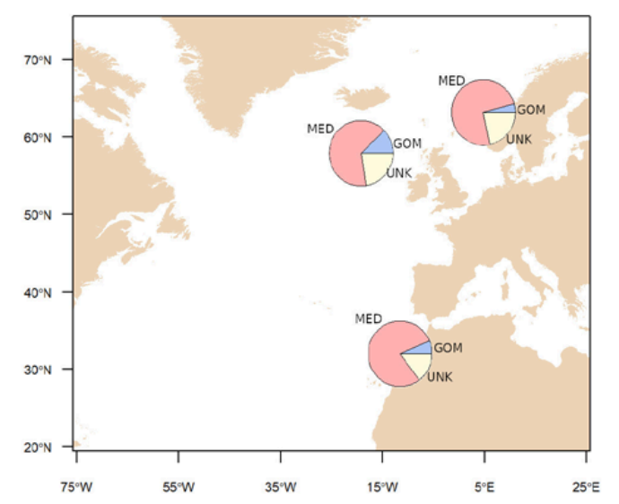
GBYP Main Research Research Activities:
4.0 Biological studies:
  Focused on collecting tissue samples and otoliths to determining the population structure and mixing and to improving the accuracy of the age length key, used for stock assessments and MSE. (1046 otoliths, 995 fin spines and 1157 tissue samples, from 1189 individuals)
Otolith Microchemistry - development an effective neural network application which successfully predicted the origin of bluefin tuna (98% accuracy).
Other activities include improvement in genetic marker data (80%), potential of epigenetic ageing BFT, Close-Kin Mark Recapture studies, and Marginal Increment Analysis (MIA) methods.
MIA results indicate opaque bands form between July and October, translucent band starts in November and peaks in May and June. Otolith ages updated.
Growth in farm studies initiated in 2019 were completed in 2022 and will be discussed in detail under the Responses to the Comm

Slide 31
GBYP Main Research Research Activities:
Modelling:
Major progress was made on the MSE and sufficiently developed to provide TAC advice for 2023 on both eastern and western BFT stocks, assuming Comm adopt.
Primarily focus on CMP development, Management Objective decisions and Communication with stakeholders (e.g., Ambassador Sessions) in 2022.
An external MSE code review concluded that the M3 model and BFT MSE code base were correctly implemented at every level.
An eastern Atlantic and Mediterranean bluefin tuna stock assessment with an external reviewer was undertaken in 2022 (BFT Exec Summary).
Review concluded that the results are indicative that abundance levels have improved from low values and likely to continue improving given recent patterns of fishing mortality (effort). However, the projection and ability to provide advice on levels of change in TAC is limited.

Slide 32
Small Tunas Year Programme (SMTYP) (10.2)
Established in 2018 to collect biological samples for growth, maturity and stock
structure studies on small tunas species (little tunny, LTA, BON, WAH). Research is conducted under contract to a consortium involving 11 entities from 9 CPCs.
Samples collected in 2020/21 include 145 BON,139 LTA, 90 WAH for a total of 374 from a broad geographical area (ATL-NE,ATL-SE, ATL-SW, and the MED).
In 2022 Analysis of the relationship between section spine diameter (mm) and fish size (FL, cm), showed area effects (Northeast Atlantic, Mediterranean and Southeast Atlantic) for LTA, but no difference for BON.
For WAH, otoliths from the 277 Southwest Atlantic were sampled for annual growth analysis are being processed - 157 slides were prepared (56%), 35 have been cut (13%), and 87 were embedded to be cut (31%).
Research results were summarized in papers and presentations at the 2022 Small Tunas Species Group Meeting.

Slide 33
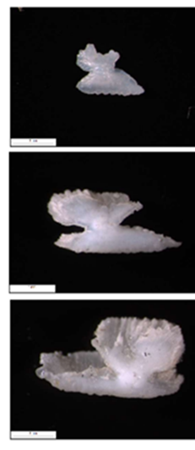
Enhanced Billfish Research Programme (EBRP)
Objectives: To obtain detailed catch and effort statistics for billfishes, to implement a tagging program, and to undertake studies on age and growth. Program further expanded in 2021 to evaluate adult habitat use, study spawning patterns, and billfish population genetics.
2022 Activities:
Otoliths sent to the FAS for age reading and a workshop (Oct 25-28) for standardizing protocols among laboratories and creating a reference set of main billfish species.
New contract issued to continue and enhance the collection of samples onboard industrial vessels
COVID-19 restrictions imposed by local authorities still affecting the activity related to the age and growth study. Analysis undertaken of length and age data for estimating the growth parameters based on spines of the main billfish species that occur in the eastern Atlantic.
September 2022, the Secretariat received a draft proposal for development of a Reproductive biology study on Atlantic blue marlin in the Gulf of Mexico.
Funds made available sampling of artisanal and small-scale fisheries (catch and effort) in the eastern Atlantic (Côte d’Ivoire, and Senegal).
WHM
146 cm
194cm
193 cm

Slide 34
Shark Research and Data Collection Programme (SRDCP)
To improve shark data collection and research, and the uncertainty of the scientific advice on sharks provided to the Commission.
Focused on shortfin mako(until 2017), porbeagle, silky shark, oceanic whitetip shark, and hammerheads in the Atlantic Ocean. 2022 Research Activities include:
Continued work on Age and growth of shortfin mako.
Genetic analysis of shortfin mako showed the existence of two distinct mitogenome clades in the Atlantic Ocean (North and South Atlantic clades). No genetic differentiation between East and West regions in the North Atlantic Ocean was observed. (96 individual collected in 2022).
Data available from 35 of the 43 tagged shortfin mako revealed a 22.9% rate of post-release mortality
Reproduction of shortfin mako and porbeagle
Movements, stock boundaries and habitat use of shortfin mako, Porbeagle, silky, oceanic whitetip, longfin mako, and hammerhead sharks in the Atlantic Ocean are being investigated through tagging. (27 tagged).
Other activities include exploration of Close-Kin Mark-Recapture (CKMR) for shortfin mako sharks. the finalization of the ICCAT Manual update and review, tag training workshop in Brazil.

Slide 35
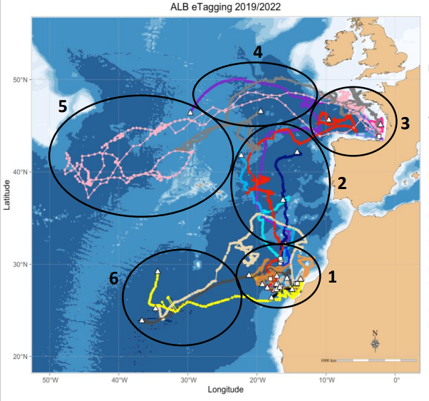
Albacore Year Programme (ALBYP)
Objective: to address key uncertainties that will improve scientific advice for management of northern and southern stocks of Atlantic albacore. The research will focus on biology and ecology, movement and habitat usage, monitoring stock status and management strategy.
2022 Actives include
Continued work on albacore reproduction for the north and south stocks.
Biological sampling in the South Atlantic off Brazil, Uruguay and South Africa)
Research on movements and habitat use of Atlantic albacore.
Short-term contract issued for technical tasks required to follow the Albacore MSE schedule after MP adoption in 2021 and to check for exceptional circumstances on a yearly basis.
Prep for 2023 benchmark stock assessment for North Atlantic using SS3 stock assessment model.
Details Appendix 11

Slide 36
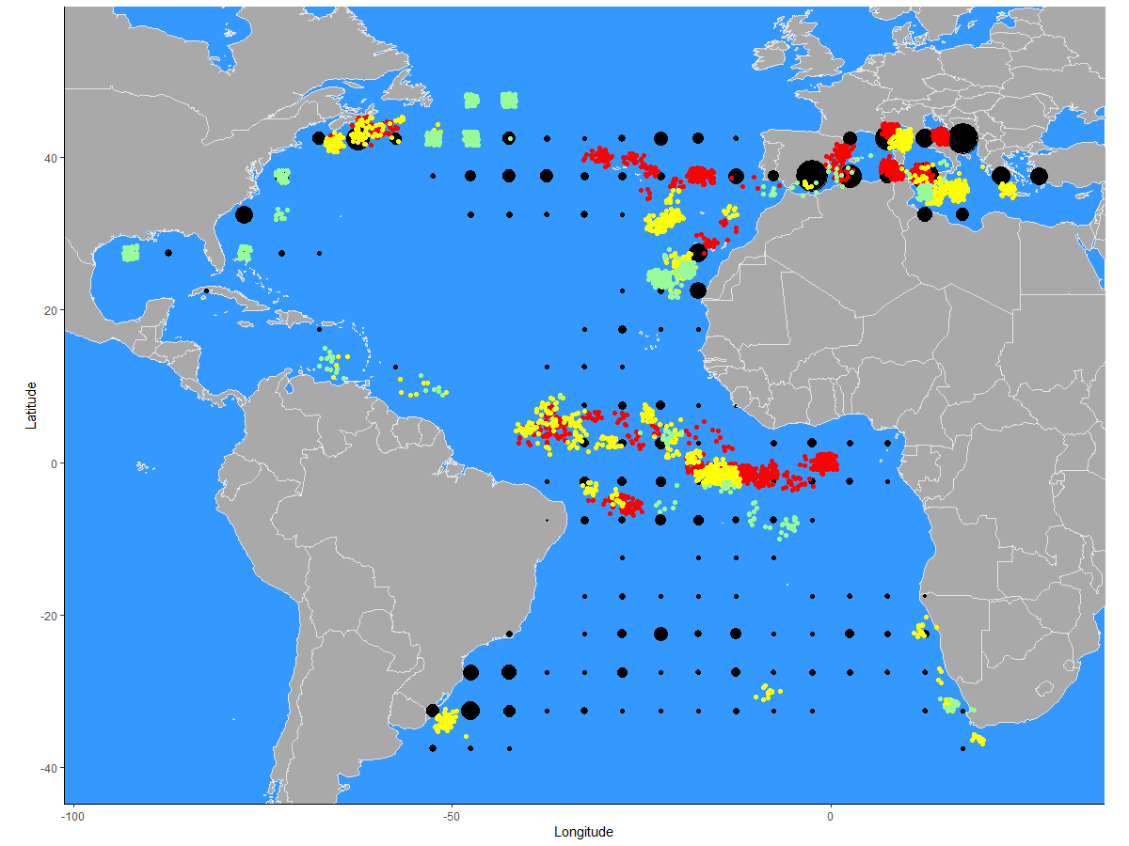
Swordfish Year Programme (SWOYP)
Objective: to address key uncertainties important for
improving the scientific advice for management of the stocks focusing ageing and growth, reproductive biology, genetics as well as movement and habitat utilization.
Samples under Phase 1-3
4159 swordfish sampled from three ICCAT managed stocks.
Tagging studies developed to explore the vertical habitat-use and migration patterns of swordfish, delimit the stock boundaries and mixing Mediterranean Sea and the North and South Atlantic.
To date, 26 miniPAT tags have been deployed in the North (13) and South Atlantic (9) and the Mediterranean Sea (4).
N-SWO grid was re-conditioned using SS3 creating a 216-model grid.
Engage with Panel 4 and stakeholders to refine performance metrics and development and selection of a MP
On track to provide CMPs to the Commission in 2023. (began 2018).
Multi-institutional Program with members from 20 institutes representing 14 ICCAT CPCs/Non-Contracting Parties on both sides of the Atlantic
Details Appendix 11

Slide 37
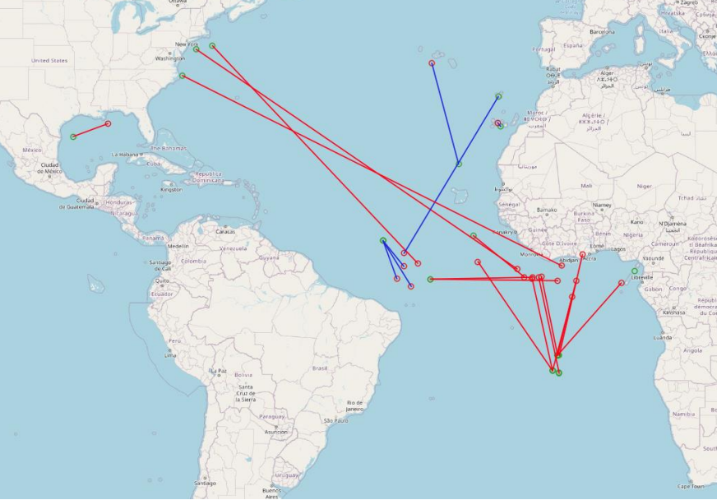
The Atlantic Ocean Tropical tuna Tagging Programme (AOTTP)
Other research activities (on tropical tunas)
The 5-year project officially began in June 2015 and end early 2021.
Ongoing activates associated with the AOTTP activities
Special Issue of Fisheries Research Journal nearly complete
with 1 paper still outstanding.
  tag recovery and rewarding;
  tag seeding experiments;
  Additional tagging in Senegal and Côte d’Ivoire
  ageing study; and
  tagging in the north-western Atlantic
25 BET and YFT conventional tags recovered between October 2021 and September 2022

Slide 38

2022 Management Strategy Evaluations (MSE) Update

Slide 39
- MSE began in 2015 with frameworks proposed for Northern Albacore, Tropical tunas, Bluefin tuna and northern swordfish to management advice.
- Early development was slow for several reasons: inexperience, technical challenges, and limited resources and the need to continue with multiple assessments to provide advice until the MSE process was completed.
- In 2018 the Commission recommended a focus on one or two species without guidance on priorities.
- In 2019 the SCRS focused on BFT and SWO_N, with limited work on ALB_N, and even less on tropical tuna MSE.
- However, in 2020 the SCRS initiated a concerted effort to move forward with MSE on all 4 species, albeit the level of effort varied from species to species. Main activities are described in the MSE Road Map.
Background:
Management Strategy Evaluations (MSE)

Slide 40
- No exceptional circumstances were identified in 2022.
- Contractors evaluated the performance of MP variants requested in Rec. 21-04, for varying levels of target fishing mortality and biomass thresholds and evaluated MP performance when only some of the CPUE series were available as well as initial tests with varying levels of underreporting. No major concerns were identified.
- Preparation work undertaken for a new MSE framework using the Stock Synthesis (SS) model with the initial SS3 models runs and results presented to the Species Group
Management Strategy Evaluations (MSE)
Timeline: Adoption of a final management procedure with HCR for northern albacore in 2021, and adoption management procedures for bluefin tuna in 2022, and northern swordfish in 2023 and tropical tunas as soon as 2024, contingent on funding, prioritization, and other work of the Commission and SCRS. Significant Progress made on all MSE frameworks. Specifically:
Highlights for 2022: Northern Albacore
Notes:
.

Slide 41
- Effort in 2022 focused on the Northern and Southern Stock assessments.
- Significant progress made on SWO MSE framework in 2022.
- The current OMs are composed of an uncertainty grid of 216 Stock Synthesis III (SS3) models with a range of assumed values for natural mortality, variance in recruitment deviations, and steepness, and the degree of observation error in the indices of abundance.
- Reconditioning the OM grid integrated the 2022 northern swordfish stock assessment model (and associated indices and data) as a base case.
- Work continued the development of the performance metrics, finalizing the OM grid, and evaluating the relative importance of the uncertainties to the selection of the CMPs.
- Work also progressed on analyses related to minimum size limits and discarding estimation.
- Improved Communication with Panel 4 and stakeholders on the refinement of performance metrics, and the development and selection of an MP is planned for 2023.
(https://iccat.github.io/nswo-mse/).
Management Strategy Evaluations (MSE)
Highlights for 2022: Northern Swordfish
Notes:
.

Slide 42
Management Strategy Evaluations (MSE)
Highlights for 2022: Bluefin Tuna
The SCRS Bluefin Tuna Species Group has made significant progress on MSE through 8 intersessional meetings, including three Panel 2 meetings and a series of Ambassador meetings.
This has been major accomplishment and effort by all involved with numerous ad hoc and unofficial meetings as well.
The latest CMP results incorporated the abundance indices up to 2021.
The number of CMP’s has been reduced from 11 original to 2 over the year based on several factors including a ranking process.
Several key decision points relating to safety, stock status, management cycle, stability, management procedure, and review period are yet to be finalized after some additional analysis by the SCRS is provided.
Once resolved the BFT MSE is ready to be implemented and to provide TAC advice for both the east and the west BFT stocks.
Further details to be discussed in the SCRS Panel 2 presentation and meeting.

Slide 43
Management Strategy Evaluations (MSE)
Highlights for 2022: Tropical Tunas
Tropical Tuna: - Parallel development of two MSE frameworks – western Skipjack and the multispecies (YFT, BET, and SKJ).
Major focus in 2022 on the east and west Skipjack stock assessment. (Discussed under Panel 1)
For WSKJ MSE the initial operating models were conditioned with data for 1952 to 2020 following the 2022 skipjack stock assessment.
Robustness tests were conducted for recruitment variability and different levels of catch overages
The Multi-stock MSE is not as advanced. At present, yellowfin and bigeye single-species operating models (OM) are available and preliminary conditioning is complete. for such OMs
Tasks to be completed include Harmonization of the fleet structure, conditioning the skipjack OM following the results of the 2022 E-SKJ stock assessment model, 3) linking the conditioned OMs of the three stocks,
The Committee noted the importance of communication with stakeholders and recommended a Panel 1 meeting for MSE discussions in 2023.
Training workshops on MSE and HCR for Portuguese and Spanish speaking scientists and managers under JCAP/ICCAT
Notes:
. (E.g., increase transparency, sources of uncertainty, better representation of results to illustrate variability of results across models, clarification of some parameters and additional checks to explain and understand the unexpected behaviour of some Operating Models)

Slide 44
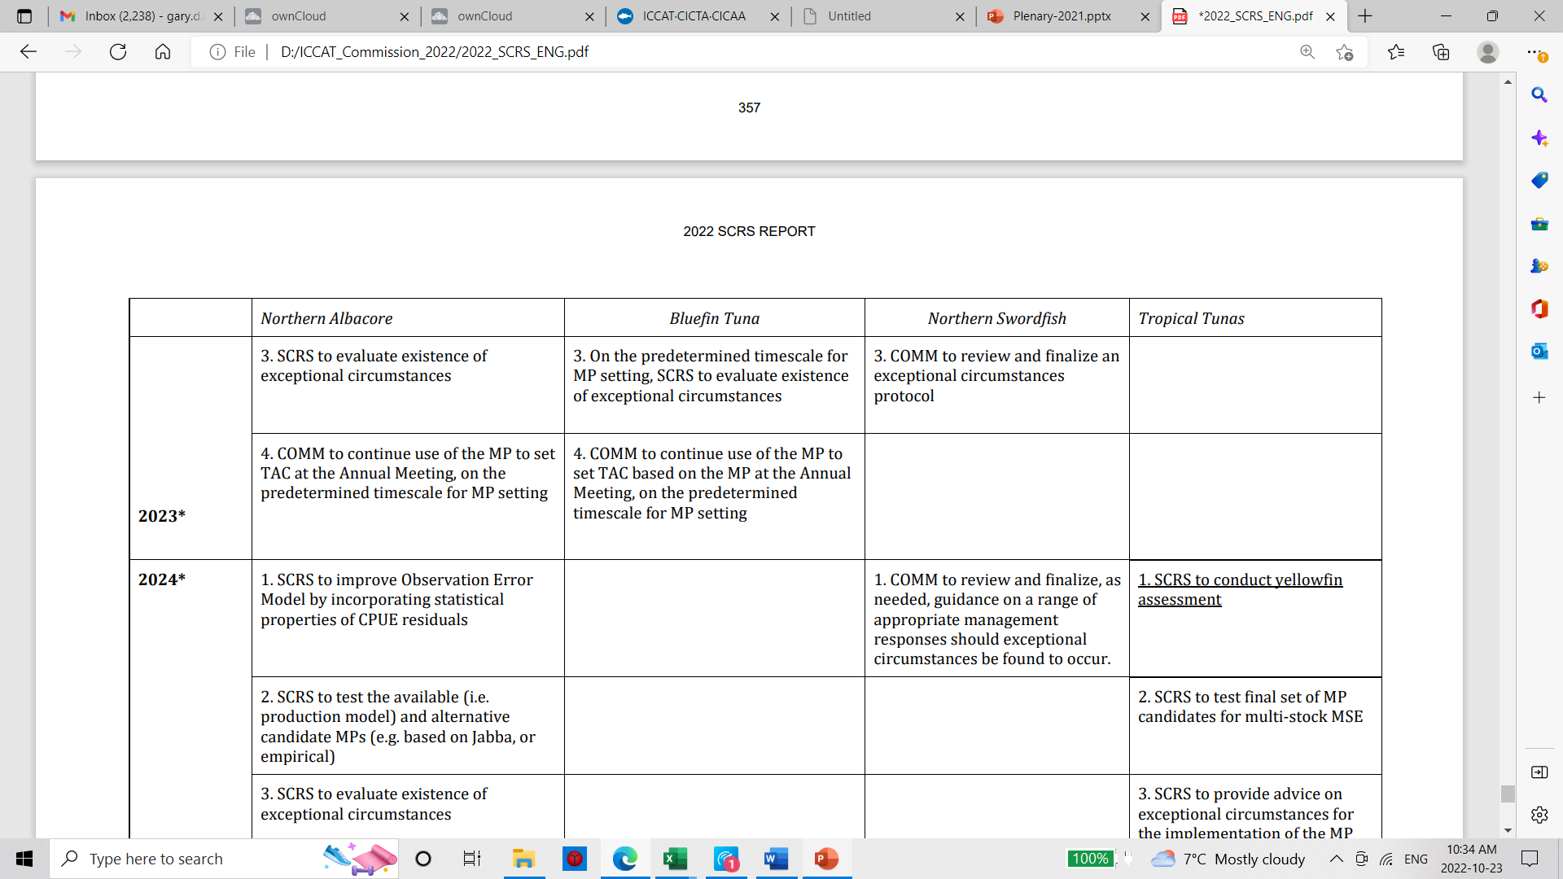
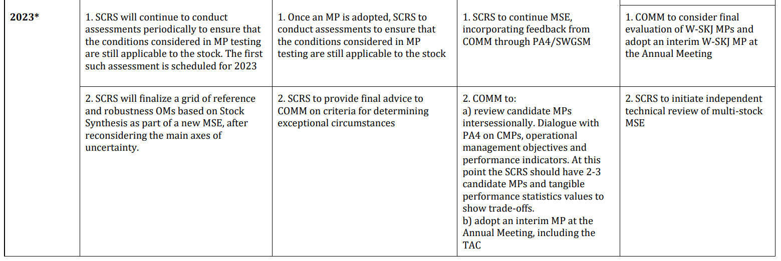
2023 MSE Road Map: Only the Northern Albacore and Tropical tunas MSE roadmaps were revised by the Committee
Complete Table (2015-2025) shown in Appendix 16

Slide 45
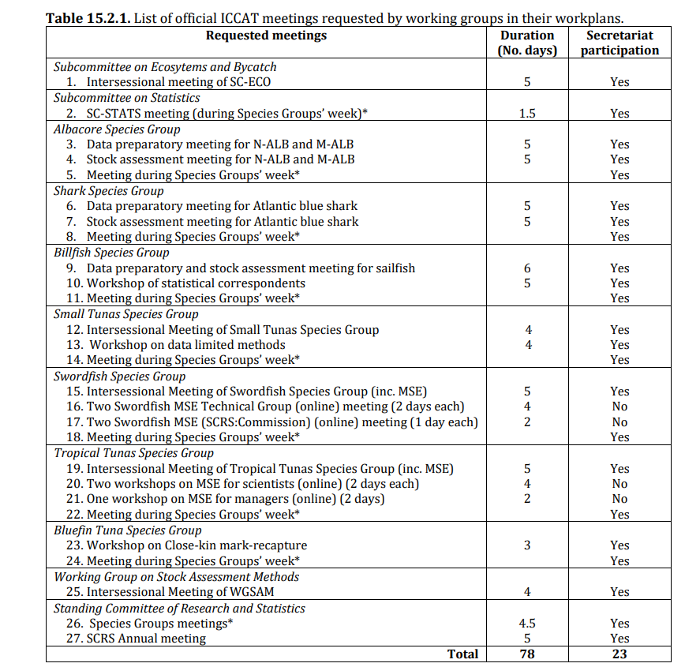
SCRS
Intersessional Meetings proposed for 2023.
Data Prep and Stock assessments will be conducted for Northern and Med Albacore, Atlantic Blue Shark, and Sailfish, plus 5 ongoing MSE processes.
This represents 27 meetings and approximately 78 days of SCRS associated meetings in 2023 (Details in Section 15.2).

Slide 46
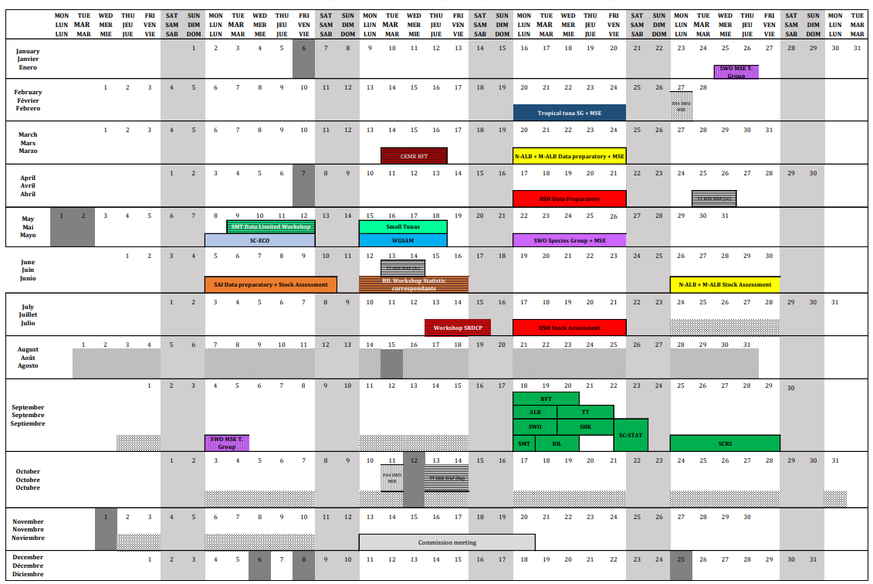
Proposed
SCRS Calendar for 2023

Slide 47
Recommendations with financial implications
Note: Species working group recommendations with financial implications will be presented in the appropriate panel.
Stock assessment methods (WGSAM): 2023 Budget (€65,000)
- Bycatch estimation tool similar to SDM/LLSIM and the bycatch estimation tool be further explored to address the SCRS general need to estimate bycatch of species (not limited to, billfish and shark). this work be carried out in 2022 under a contracted expert.
- Website engine search tool for scientific papers: Documents to be OCRed to make the contents searchable and indexed. Requires a dedicated staff member or a short-term contract to set system up
Sub-committee on Ecosystems and By-catch : 2023 Budget(€65,000)
- financial assistance to complete the development of a quasi-quantitative tool for evaluating species of priority for management
- financial assistance for 5-7 scientists to attend a collaborative workshop on the relevance and delineation of candidate ecoregions within the ICCAT Convention area to foster discussion on operationalizing the EBFM.
The Sub-committee on Statistics : 2023 Budget (€6,000)
– The Committee recommended continued development of interactive front-end applications for making and publishing graphical dashboards of ICCAT statistical datasets and provide the necessary financial resources for its full implementation.

Slide 48
SCRS Chair Chair
SCRS Chair Elections
Dr Gary Melvin will step as Chair of the SCRS after 4 years in office at the end of this year.
Elections were held during the 2022 SCRS Plenary with two individuals being nominated for the position.
Pleased to announce that Dr Craig Brown of the USA was elected as SCRS Chair for a two-year term.
Dr Brown noted that he will decide on a Vice Chair in the near future.
Data dissemination.
No editorial changes were received to the AMENDMENT OF THE RULES AND PROCEDURES FOR THE PROTECTION, ACCESS TO, AND DISSEMINATION OF DATA COMPILED BY ICCAT, which was adopted last year by the Commission (as doc PLE-11A/2021) but provisionally for 1 year.
Can this amendment (posted as PLE-110) now be considered adopted as it is?
Notes:
. (E.g., increase transparency, sources of uncertainty, better representation of results to illustrate variability of results across models, clarification of some parameters and additional checks to explain and understand the unexpected behaviour of some Operating Models)

Slide 49
Priorities and interpreting costs for SCRS intersessional meetings
Last year the SCRS introduced a proposal to increase the interpretation at official SCRS meetings beyond the traditional Plenary.
The purpose was to increase the understanding and active participation of non-English speaking members.
Although the proposal provided a number of options and meeting type priorities, the request for funding was declined until further information requested by the Commission was made available.
This information is provided in SCI-152B and contains analyses based on number of participants and the number pf CPC which would benefit.
The proposal will be discussed further during StacFad.

